Slide 1

HOME PAGE
It is the main page of this web site
It consists of menu options , description of hospital

Slide 2
Options on HOME PAGE
The options on homepage are:
HOME
MENU
ABOUT US
NEARBY CLINICS
Menu option further consist of following options
Login
register

Slide 3
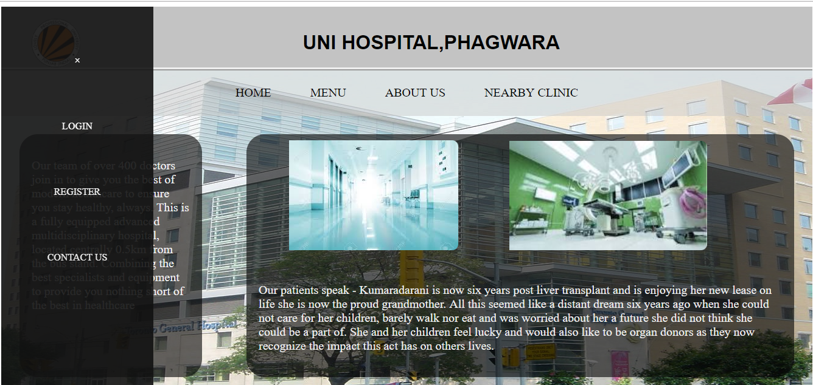
We have used some javascript to make this
Side Navigation menu

